Slide 1
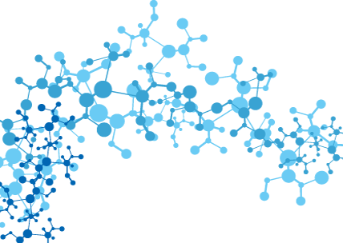
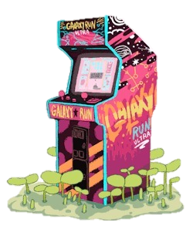

Neuroevolution deep reinforcement learning
Itai Schwed
Aviva shneor simchon

Slide 2


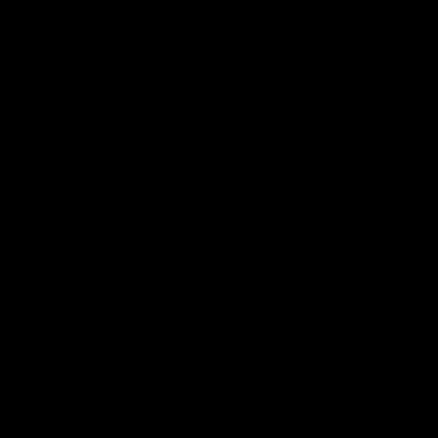








Slide 3

The End, Thank You

Slide 4

Reinforcement Learning

Slide 5
states
actions
rewards

Slide 6
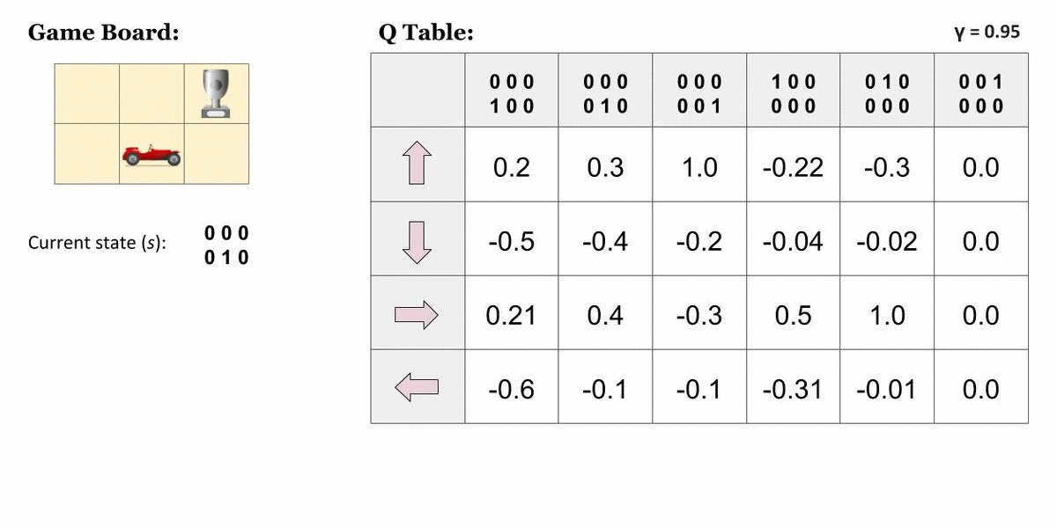
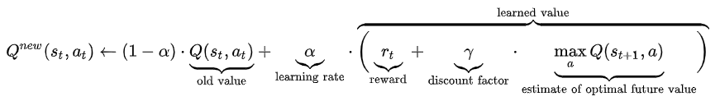

Slide 7
Genetic Algorithms

Slide 8
8
4
9.9
3.2
7.4
2.1
2
5
2
8.6
4.2
7.7
4.5
1
9.5
2.7
9.3
3.9
8.4
4

Slide 9
Paper

Slide 10

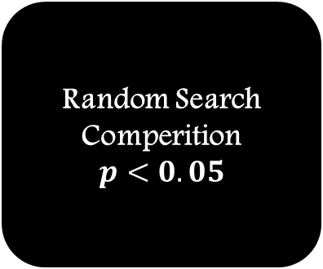
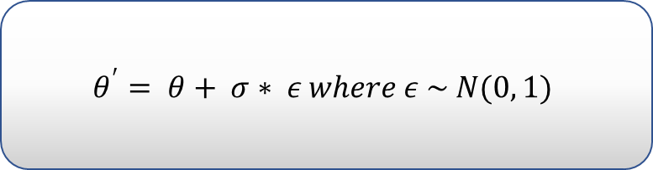
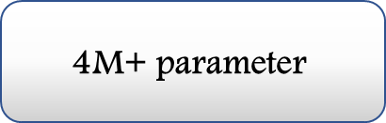
20/04/18
Deep Neuroevolution:
Genetic Algorithms Are a Competitive Alternative for Training Deep Neural Networks for Reinforcement Learning
Citation impact 311
DQN
Neuroevolution Deep Reinforcement Learning
5000 sized population
Reward as Fitness
$$θ^{′}= θ+ σ∗ ε where ε \sim N(0, 1)$$
Truncation Selection based Genetic Algorithms - Elitism
$$\text{4}\text{M}\text{+ }\text{parameter}$$
Seeds Based Networks 8,000-50,000-fold
Atari Frostbite pixsels based
Conv - 4, 32, (8, 8), 4
Conv - 32, 64, (4, 4), 2
Conv -64, 64, (3, 3), 1
Linear - 4 * 4 * 64, 512
Linear - 512, 18
Random Search Comperition
$$p<0.05$$
Random Initialization
720 cores CPU – 1h

Slide 11
Runs

Slide 12
My Computer
Bar Elan Servers
AWS
Bar Elan Servers
Blog Code
Google Cloud

Slide 13
Results

Slide 14
 | DQN | PAPER NEDRL | BLOG NEDRL | OUR NEDRL
Frostbite | 797 | 4,801 | 4,570 | 5,420
Cores | - | 720 | 360 | 30
Time | 7 – 10 days | 1 hour | 2 hours | 24 hours

Slide 15

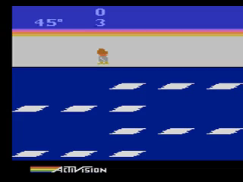

Slide 16


Slide 17
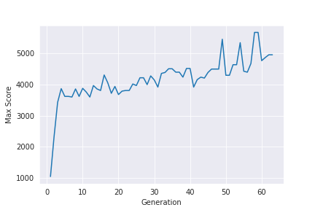
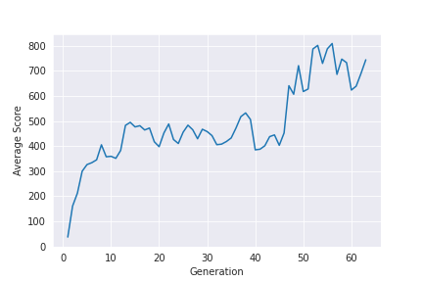
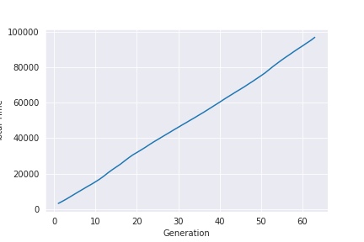
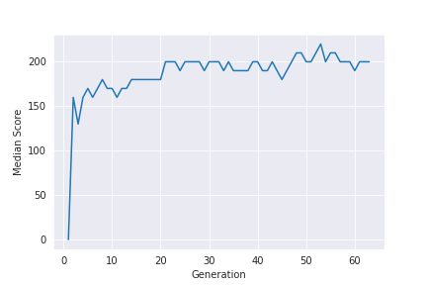

Slide 18
Our Trial

Slide 19
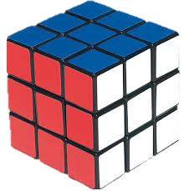
Combinatorial problem
Gym wrapping environment
Binary Reward
Max steps

Slide 20





Slide 21
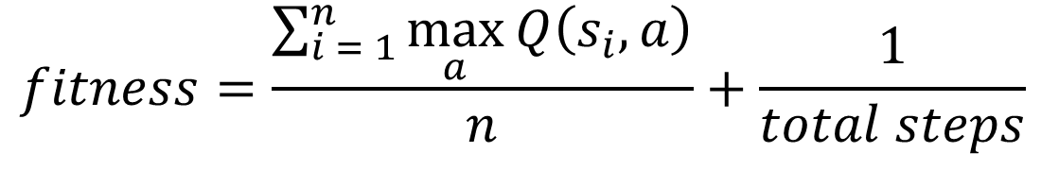
$$fitness=\frac{\sum_{i = 1}^{n}{\max_{a}{Q\left(s_{i}, a\right)}}}{n}+\frac{1}{total steps}$$

Slide 22
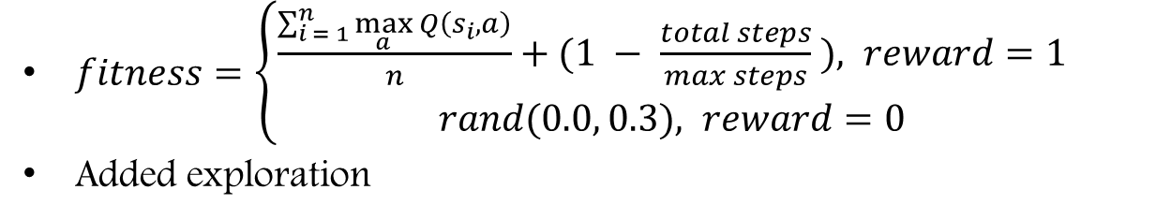
$fitness=\left\{\begin{aligned}\frac{\sum_{i = 1}^{n}{\max_{a}{Q\left(s_{i}, a\right)}}}{n}+(1 − \frac{total steps}{max steps} ), reward=1 \\ &rand(0.0, 0.3), reward=0\end{aligned}\right.$
Added exploration

Slide 23
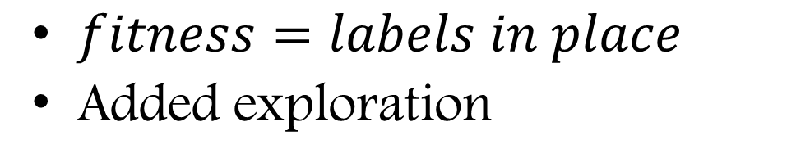
$fitness=labels in place$
Added exploration

Slide 24
Conclusions

Slide 25
Low cost
Low memory
Continuous/Integer Reward
Networks not learning
Primitive genetic algorithm
Combined NEDRL and Q learning
Easy environment to run

